Slide 1
Flyweight Design Pattern
By: Underviserne

Slide 2
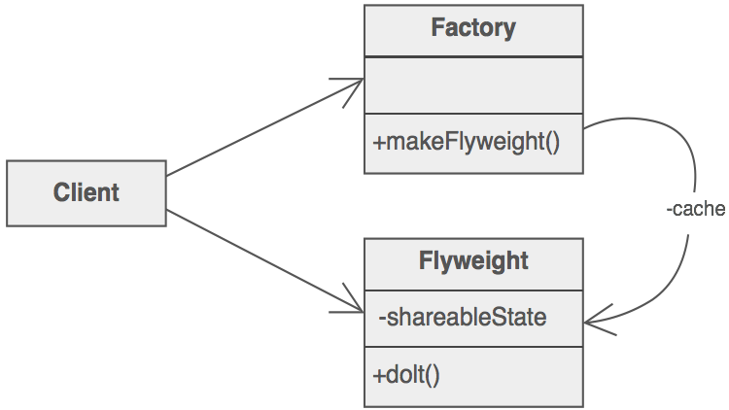
Introduction
Structural pattern
Goal of the pattern
How it works

Slide 3
Comparison
No direct comparison
Different goals than other patterns

Slide 4
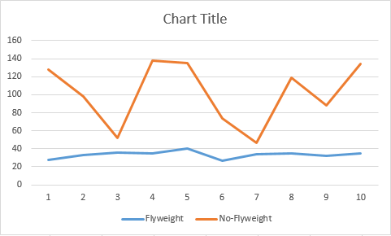
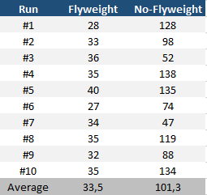
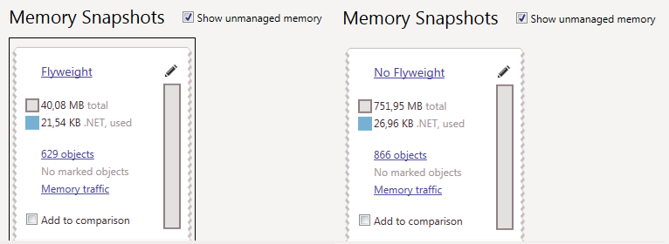
Example

Slide 5
Conclusion
When to use flyweight pattern?
Where is it used in known software?

